Slide 1











RSight® Agentic AI for recruitment
®
AI Recruitment Intelligence. Human Connections.

Slide 2




150 billions € p/a:
poor hiring decisions cost on a global scale
45% of companies:
say they can’t find the skills they need
39 days:
average time-to-hire an employee
The problems our clients are facing
RSight® is addressing all these challenges.
Confidential

Slide 3




WHAT
IS “RSight® Agentic AI”?
RSight® is an Artificial Intelligence (AI) who assists organizations to find the right Talents with an unseen simplicity and cost.​
RSight®
Artificial Intelligence
WHAT
DO YOU GET?
Driven by people. Powered by purposes. Elevated through innovation.
Our Agentic AI supports your team and provides you continuously with Talents who :​
are screened and qualified​
match your recruitment request expectations​
and consider to be recruited by your organization
© 2025 RSight®

Slide 4
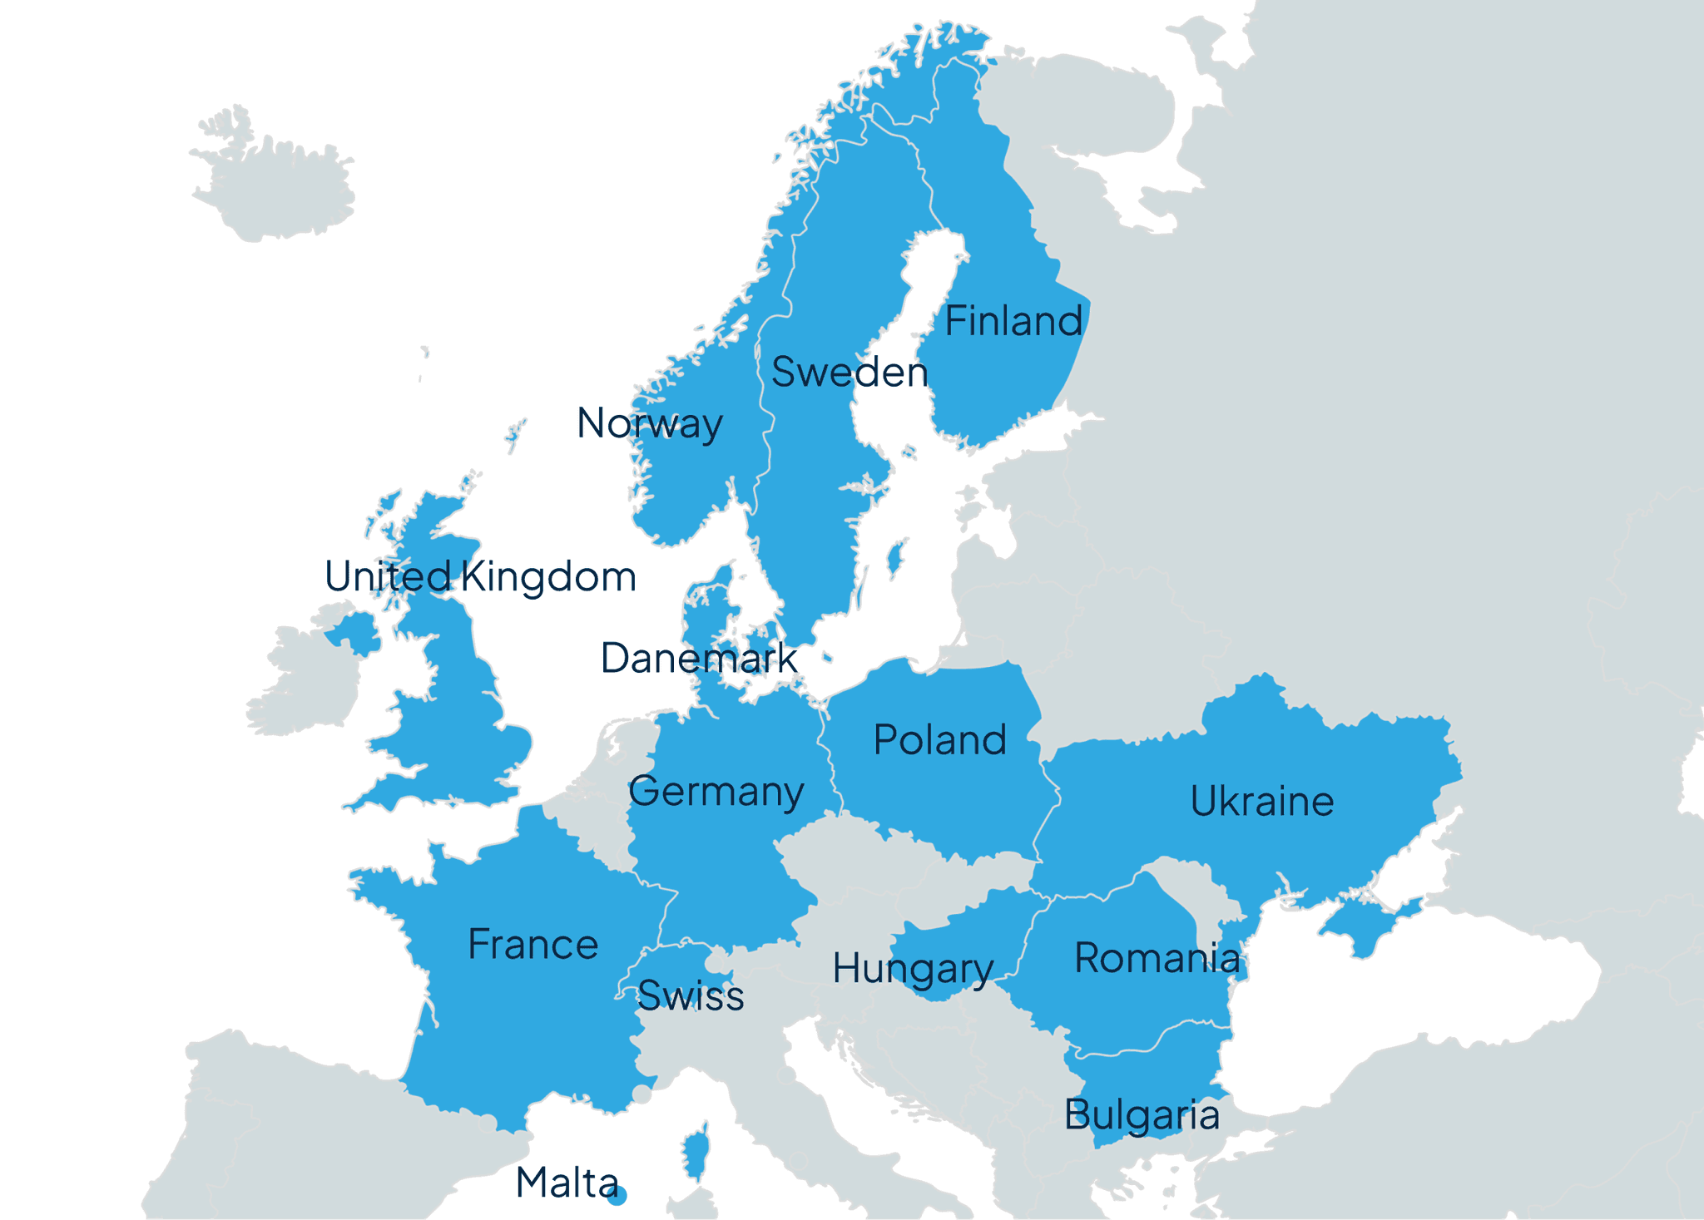













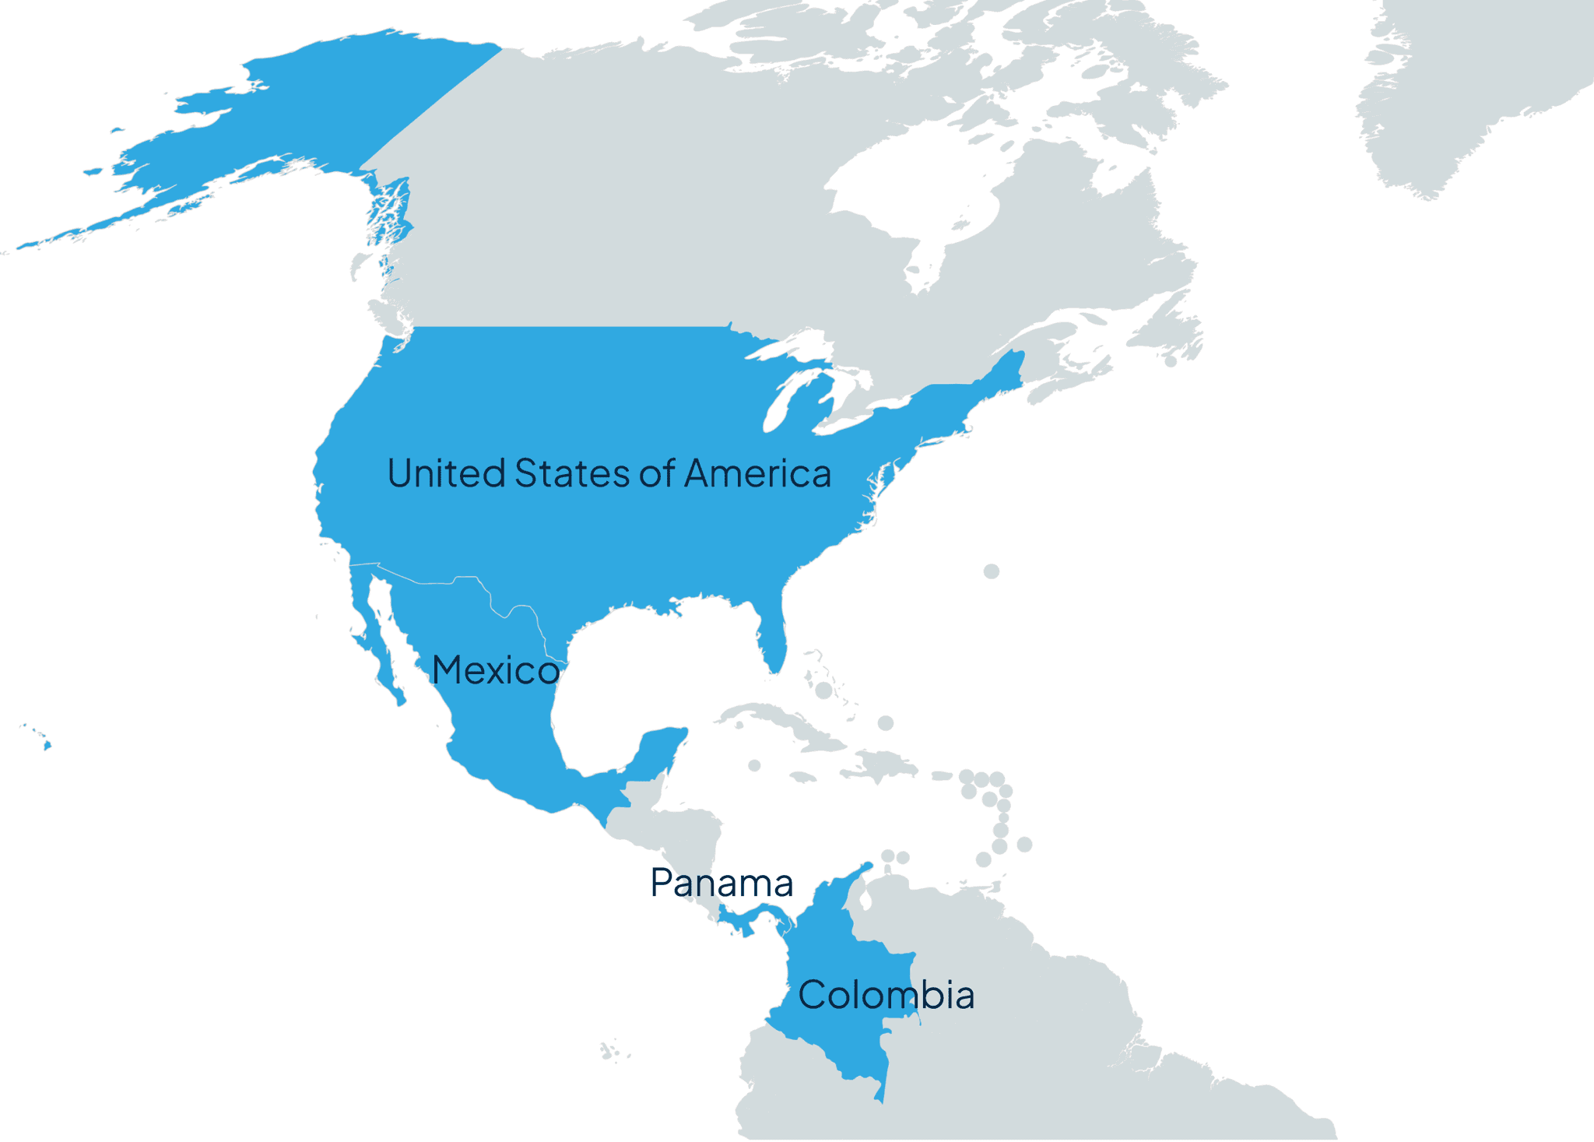
RSight® geographic coverage :
Our clients can recruit in 200+ countries and territories worldwide
They already recruited in 19+ countries
RSight® main characteristics
Connectors to 100+ ATS / HRIS like:
50
+
RSight® AI
key facts
Languages
24 / 7
Able to post in:
Can hunt:
>3,5K
>1B
job-boards
~40% of the
proposed candidates
candidates (40+ sources)
~60% of the
proposed candidates
RSight® current client's footprint:
from 2 to 500.000 employees, 3 belonging to the CAC40
Our AI Recruitment metrics :
1K
50%
~
~
CVs approved & clients
interviews scheduled
Response rate for the
1st contact
80%
100%
~
Proposed candidates approved
GDPR and EU AI Act compliant
98+%
Customer satisfaction rate

Slide 5

Traditional recruitment process
What recruiters and hiring managers do
Job requisition
& approval
Recruitment strategy definition
Manual sourcing candidates in multiple databases (internal and external)
Job description & manual posting
Manually review of applications and CVs
Initial contact & pre-screening
Job offer and negotiation
Reference & background Checks
Assessment (skill tests, technical assessments, or personality evaluations)
Candidates' interviews and selection
Hiring & Onboarding

Slide 6
Recruitment process with RSight® Agentic AI
What can RSight® Agentic AI do
Captures
recruitment
details and
define strategy
Multi-posts
on thousands
of job-boards concurrently
Sources
thousands
of candidates simultaneously
Do the
scoring and matching
between
candidates & jobs
Connects
with candidates, screens and qualifies them
Candidates’
interviews & selection
Assessment (skill tests, technical assessments, or personality evaluations)
Proposes
screened and qualified candidates who match the request and are eager to be hired
Job offer and negotiation
Reference & background Checks (can be done by RSight®)
Hiring & Onboarding

Slide 7













​
BPO​
Worldwide​
~500 000 ​
​
IT equipments​
Worldwide​
~27 000​
​
Banking & FS Worldwide​
~75 000​
​
Banking & FS
Worldwide​
~145 000​
​
Banking & FS
Worldwide​
~145 000​
​
IT Services​
Worldwide​
~4 000​
​
IT Services​
Europe
~2 000​
​
Telecom​
Europe
~200​
​
IT & Consulting​
Worldwide​
~340 000​
Our clients (selection)
Our clients are at the heart of our business, spanning various industries and driving us to innovate and deliver high-quality solutions. We build lasting relationships based on trust and collaboration, ensuring their success is our priority.
​
IT Services​
Worldwide​
~18 000​
​
IT Services​
Europe
~2 200​
​
Retail​
Europe
~25 000​
Consulting​
Worldwide​
~270 000​
​
Pharma​
Worldwide​
~200​
​
Pharma​
Worldwide​
~8 200​
​
Electronics​
Worldwide​
~5 000​
​
IT Services​
Worldwide​
~10 000​
Legend top to down: Country / Industry / Geographical scope / number of employees

Slide 8

Confidential

Slide 9








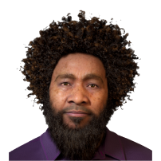
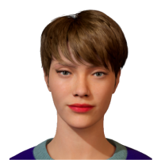












You can interact with RSight​® by
Meet our
Prompt
Click
Artificial
Intelligence
Chat
(Text)
Voice
A never-seen way of navigation
RSight® offers a groundbreaking approach to navigation, combining cutting-edge technology with intuitive design to deliver an unparalleled user experience. Discover a new way of exploring and interacting with your environment like never before.
Manage your recruitments in RSight​®
Create job requests
Approve candidates
Manage your recruitment process
Follow the progress

Slide 10
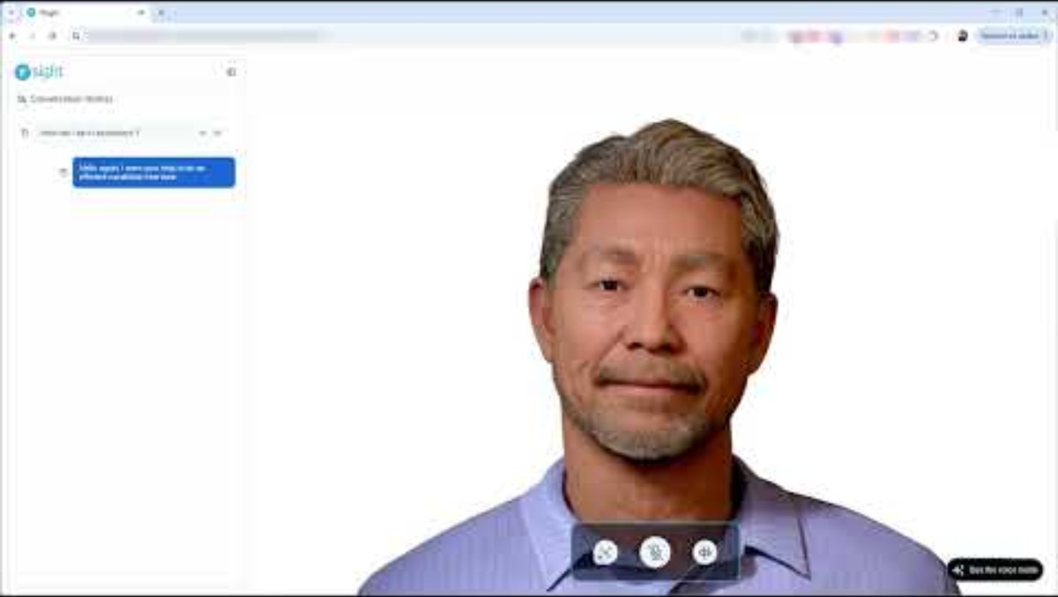
Confidential

Slide 11


